Slide 1

Frame Standards
ATLAS
Sean ZHOU

Slide 2
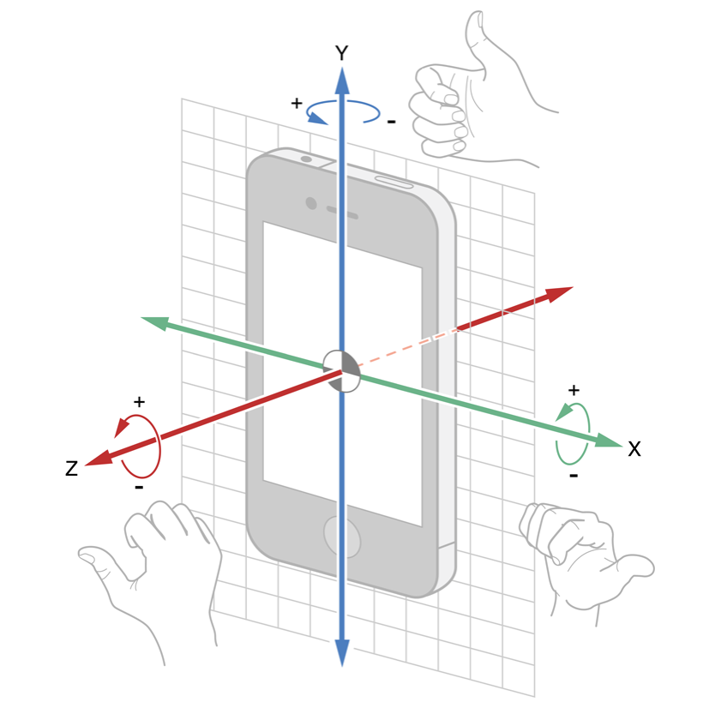
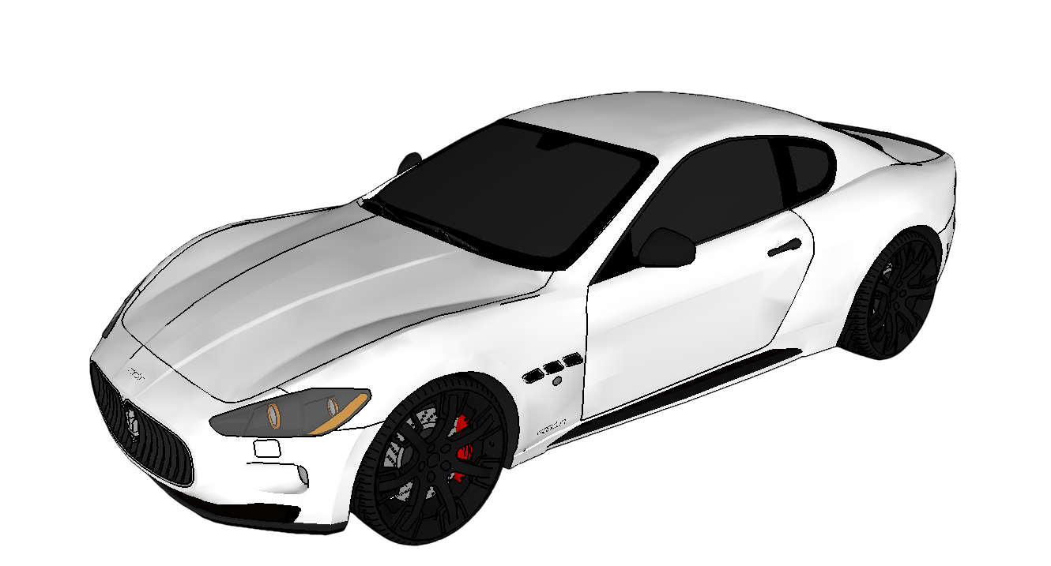
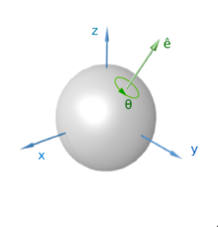
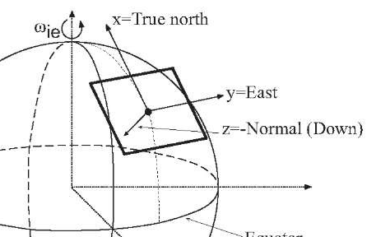
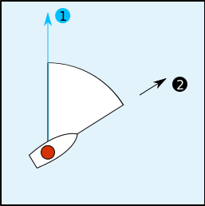
Device Frame -> Vehicle Frame -> Earth Frame
Roll
Z-axis
Device Frame
Vehicle Frame
X-axis
Yaw
Pitch
Y-axis
Course
Earth Frame
Quaternion
North (0˚)
quaternion : (scalar, x, y, z)
Clockwise 0˚~359˚

